Slide 1

Presentation Project: PIClops
Team Members: David Moore , Alex Baker, Rayan Plummer, Ernesto Macias

Slide 2
Overview
The target is to build a stand-alone video capture device that leverages off-the-shelf components to provide a simple and cost-effective mechanism to deploy to capture video at an individuals home. In addition, data associated with this capture will be kept on-premises and not in the cloud in order to preserve the ownership and security of the installer’s privacy.
Companies like Amazon, Nest, Arlo, and Wyze have all put together commercial offerings that are trivial for home users to procure and install. What all of these cameras share is a cloud storage system that provides data retention and streamlined access via slick user interfaces.
In an age of data breaches, questionable corporate data privacy policies, and data transfer limits and throttling it becomes advisable to create an offering that allows users to record, store, and maintain their own video streams in a local repository that only leverages the local area network

Slide 3
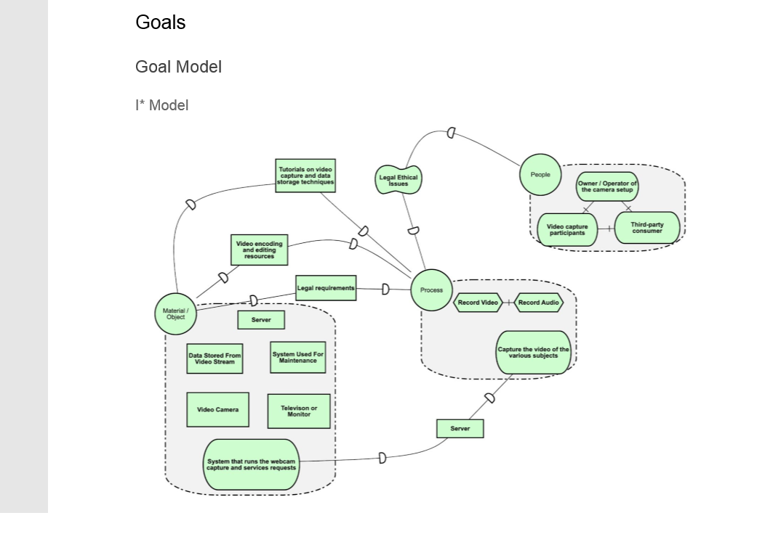
Main goals
Hard Goals: ● Simple installation & configuration ● Store files locally ● Capture the video of the various subjects ● Autonomous / unsupervised mechanism to initiative and record video Soft
Goals ● Easy to configure ● Easy to manage videos ● Quick view method to look at recorded media
● Cheap to implement ● Small and compact deployment: ● Adherence to legal and ethical requirements for video capture and storage

Slide 4
Main functional requirements
○ As a system owner, I want a quick and secure mechanism for logging into the system to ensure that a bad actor doesn’t connect to my system and manually delete files or modify configurations.
○ As a system owner, I would like a way of specifying the frame change criteria that will trigger the record feature in order to minimize the amount of unneeded video that is stored.
○ As a system owner, I would like to indicate the maximum duration that a video file should consume to ensure manageable video files for saving and sharing.
○ As a system owner, I want to indicate the amount of time in seconds that a video recording should continue after frame change criteria are gone to minimize the space consumed by my videos.
○ As a system owner, I would like to specify the maximum amount of hard drive / storage space my video files can consume to avoid saturating the entire storage device.

Slide 5
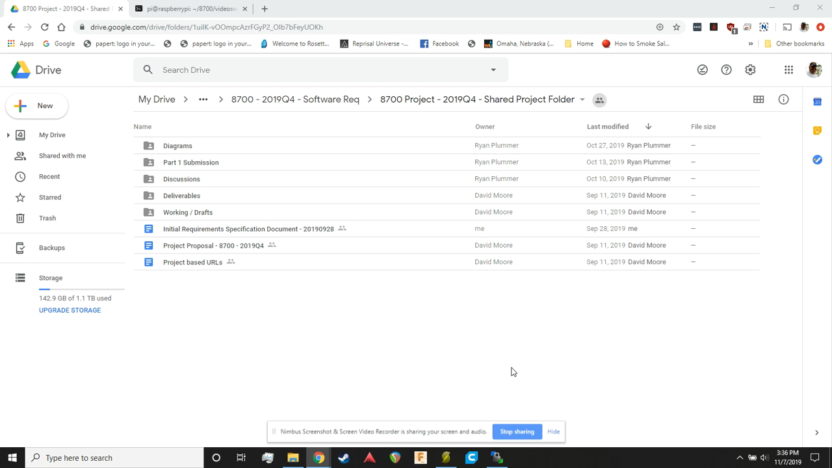
Short demo

Slide 6
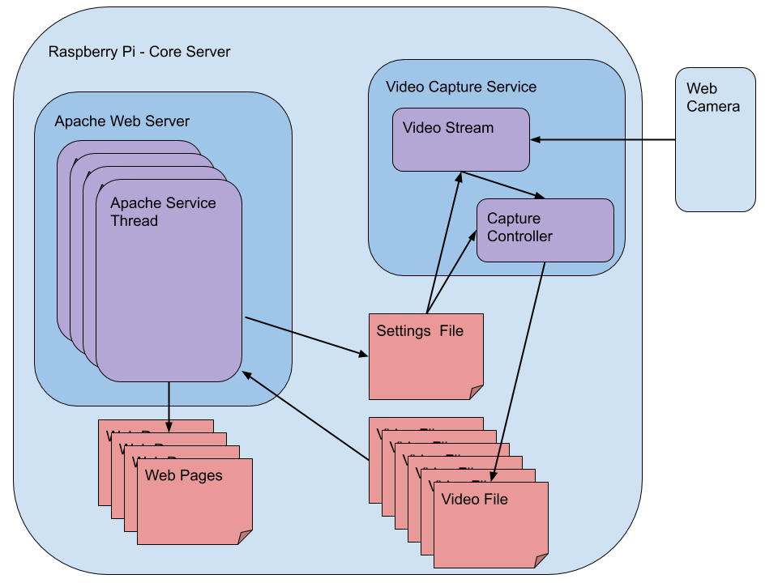
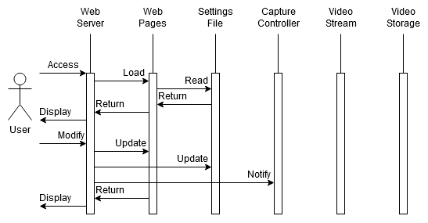
Architecture
Deployment View
Development View

Slide 7
Quality Requirements

Slide 8
Formalization

